Slide 1


Objectives
In this session, you will learn to:
  Add visual effects using jQuery
  Implement image rollover
  Create image gallery

Slide 2
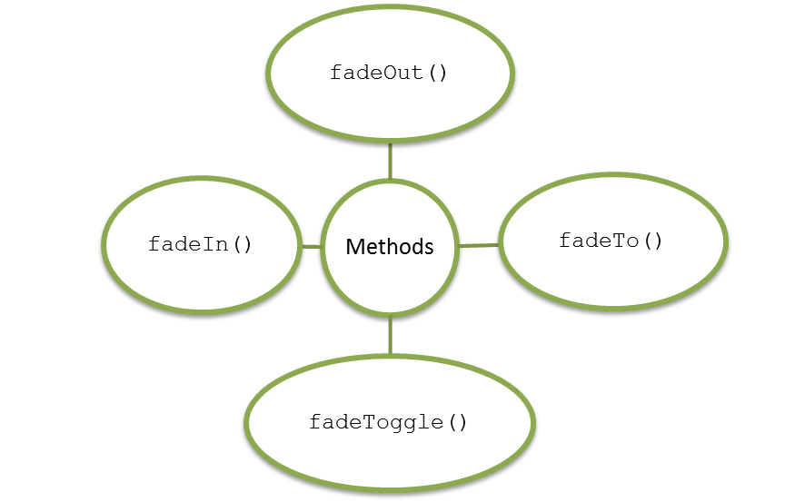
Implementing Fade Effect
The fade effect:
  Is used to gradually reduce the opacity of the selected elements.
  Can be implemented using the following functions:

Slide 3
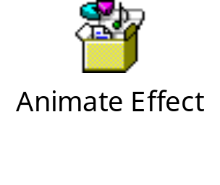
Implementing Animate Effect
The animate effect:
  Is used to create custom animations.
  Is implemented using the animate() function having the following syntax:
    animate({params},speed,callback);
  The following embedded Notepad file contains the code to implement the animate effect:

Slide 4
Just a Minute
Which one of the following functions is used to make a hidden element visible
when an event occurs?
  hide()
  show()
  toggle()
  slide()

Slide 5
Just a Minute (Contd.)
Solution:
  show()

Slide 6
Demo: Working with jQuery
Problem Statement:
  Create a Web page, Offers, in the ShowOnWheels website displaying the information
  about bank offers and lucky draws. The information should be visible only when the
  user moves the mouse pointer on the Bank Offers and Lucky Draw links.
  Prerequisite: To perform this activity, you need to use the solution of ShowOnWheels
  that you have created in Activity 6.1. In addition, you need the jquery-1.8.3.js file and
  save it in the ShowOnWheels folder. Ask your faculty to provide you the same.

Slide 7
Demo: Working with jQuery (Contd.)
Solution:
  To display the information about bank offers and lucky draws on mouse move, you need to perform the following tasks:
  1. Create the Offers.html file.
  2. Update the nav.html file.
  3. View the Offers.html file.

Slide 8
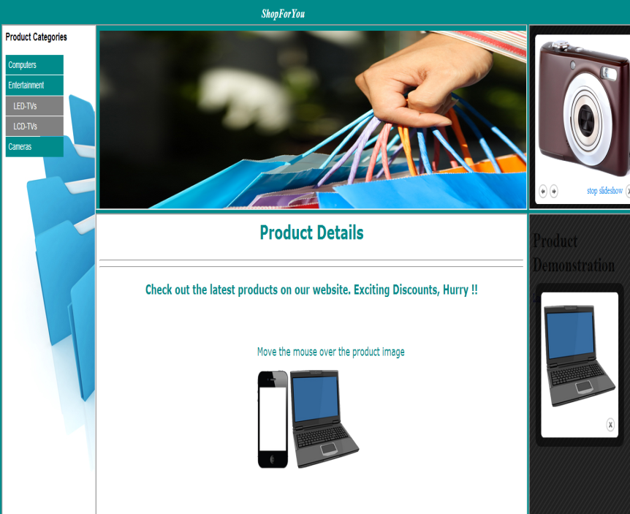

Implementing Image Rollover
Scenario:
When a user moves the mouse pointer on an image of a product
Another image showing enlarged view or information about that product appears on a Web page
This is done by creating the image rollover effect

Slide 9
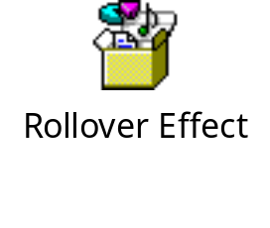
Creating Image Rollover
Image rollover is an effect in which the appearance of an image changes when the mouse pointer is placed or moved on it.
  The following embedded Notepad file contains the code that shows how to implement the image rollover effect:

Slide 10
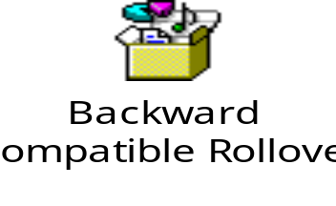
Creating Backward Compatible Rollover
The backward compatible rollover:
  Helps capture mouse events on images in all the browsers.
  Can be implemented using the <A> tag and placing all the images using the <IMG> tag
  within it.
  The following embedded Notepad file contains the code to implement the backward
  compatible rollover effect:

Slide 11
Preloading Images
  Preloading images:
  Is a technique to load images in the browser cache before the script on the Web page is executed.
  Helps to avoid delay in loading images.
  Can be implemented using the Image object.

Slide 12
Creating Image Gallery
An image gallery:
  Is a collection of thumbnail pictures or image links.
  Is created using the jQuery plugins.
jQuery plugins are prewritten and easy to use programs to enhance the jQuery code.
The following jQuery plugins can be used to create an image gallery:
  The colorbox plugin
  The galleria plugin

Slide 13
Using Colorbox Plugin
The colorbox plugin:
  Enables displaying a collection of images one by one using the previous and next
  buttons.
  Can be used to display an image with a variety of transition effects, such as fade or
  elastic.
  Can be used by downloading the colorbox.zip file.

Slide 14
Summary
In this session, you learned that:
  The fade effect is used to gradually reduce the opacity of the selected elements.
  The animate effect is used to create custom animations.
  Image rollover is an effect in which the appearance of an image changes when the mouse pointer is placed or moved on it.
  The backward compatible rollover helps capture mouse events on images in all the browsers.
  Preloading images is a technique to load images in the browser cache before the script on the Web page is executed.
  jQuery plugins are prewritten and easy to use programs to enhance the jQuery code.
  The colorbox plugin enables displaying a collection of images one by one using the previous and next buttons.

